Slide 1
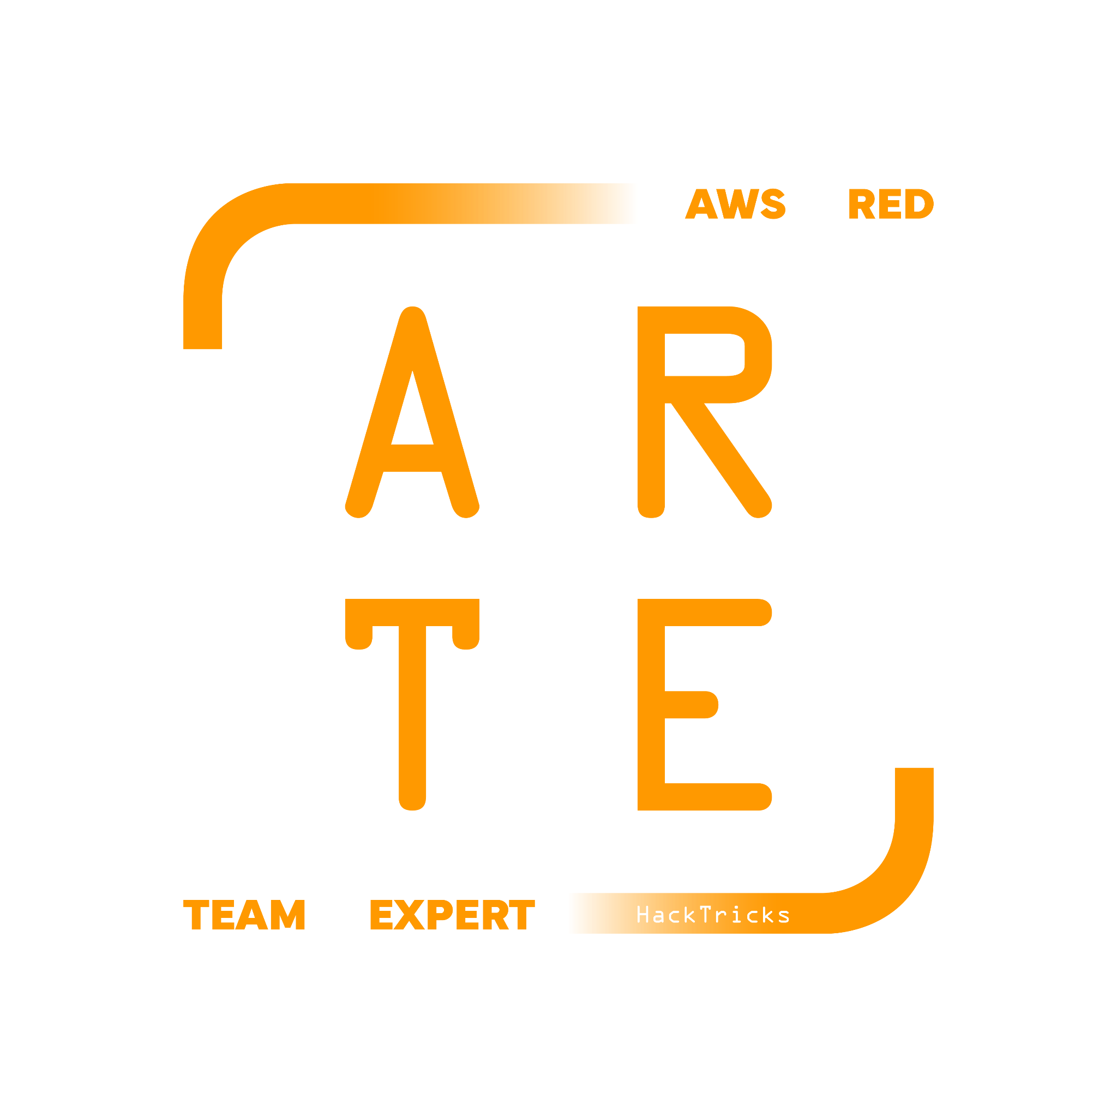
ECS
Elastic Container Service
HackTricks Training
https://t.me/CyberFreeCourses

Slide 2
Basic Information
Amazon Elastic Container Services or ECS provides a platform to host containerized applications in the cloud. ECS has two deployment methods, EC2 instance type and a serverless option, Fargate. The service makes running containers in the cloud very easy and pain free.
ECS operates using the following three building blocks: Clusters, Services, and Task Definitions.
https://t.me/CyberFreeCourses
https://cloud.hacktricks.xyz/pentesting-cloud/aws-security/aws-services/aws-ecs-enum

Slide 3
Clusters
Clusters are groups of containers that are running in the cloud.
There are two launch types for containers, EC2 and Fargate.
AWS defines the EC2 launch type as allowing customers “to run [their] containerized applications on a cluster of Amazon EC2 instances that [they] manage”.
Fargate is similar and is defined as “[allowing] you to run your containerized applications without the need to provision and manage the backend infrastructure”.
https://t.me/CyberFreeCourses
https://cloud.hacktricks.xyz/pentesting-cloud/aws-security/aws-services/aws-ecs-enum

Slide 4
Services
Services are created inside a cluster and responsible for running the tasks. Inside a service definition you define the number of tasks to run, auto scaling, capacity provider (Fargate/EC2/External), networking information such as VPC’s, subnets, and security groups.
There 2 types of applications:
Service: A group of tasks handling a long-running computing work that can be stopped and restarted. For example, a web application.
Task: A standalone task that runs and terminates. For example, a batch job.
Among the service applications, there are 2 types of service schedulers:
REPLICA: The replica scheduling strategy places and maintains the desired number of tasks across your cluster. If for some reason a task shut down, a new one is launched in the same or different node.
DAEMON: Deploys exactly one task on each active instance that has the needed requirements. There is no need to specify a desired number of tasks, a task placement strategy, or use Service Auto Scaling policies.
https://t.me/CyberFreeCourses
https://cloud.hacktricks.xyz/pentesting-cloud/aws-security/aws-services/aws-ecs-enum

Slide 5
Task Definitions
Task Definitions are responsible for defining what containers will run and the various parameters that will be configured with the containers such as port mappings with the host, env variables, Docker entrypoint...
Check env variables for sensitive info!
https://t.me/CyberFreeCourses
https://cloud.hacktricks.xyz/pentesting-cloud/aws-security/aws-services/aws-ecs-enum

Slide 6
Manual Enumeration
# Clusters info
aws ecs list-clusters
aws ecs describe-clusters --clusters <cluster>
# Container instances
## An Amazon ECS container instance is an Amazon EC2 instance that is running the Amazon ECS container agent and has been registered into an Amazon ECS cluster.
aws ecs list-container-instances
aws ecs describe-container-instances
# Services info
aws ecs list-services --cluster <cluster>
aws ecs describe-services --cluster <cluster> --services <services>
aws ecs describe-task-sets --cluster <cluster> --service <service>
# Task definitions
aws ecs list-task-definition-families
aws ecs list-task-definitions
aws ecs list-tasks --cluster <cluster>
aws ecs describe-tasks --cluster <cluster> --tasks <tasks>
## Look for env vars and secrets used from the task definition
aws ecs describe-task-definition --task-definition <TASK_NAME>:<VERSION>
https://t.me/CyberFreeCourses
https://cloud.hacktricks.xyz/pentesting-cloud/aws-security/aws-services/aws-ecs-enum

Slide 7
Unauth Access
Exposed port of running tasks
https://t.me/CyberFreeCourses
https://cloud.hacktricks.xyz/pentesting-cloud/aws-security/aws-unauthenticated-enum-access/aws-ecs-unauthenticated-enum

Slide 8
Privilege Escalation
iam:PassRole, ecs:RegisterTaskDefinition, (ecs:RunTask, ecs:StartTask)
Steal ECS roles
iam:PassRole, ecs:RegisterTaskDefinition, (ecs:UpdateService|ecs:CreateService)
Steal ECS roles
ecs:RegisterTaskDefinition, (ecs:RunTask|ecs:StartTask|ecs:UpdateService|ecs:CreateService)
Compromise the EC2 host and EC2 IAM role
ecs:ExecuteCommand, ecs:DescribeTasks,(ecs:RunTask|ecs:StartTask|ecs:UpdateService|ecs:CreateService)
Compromise ECS IAM credentials executing a command inside the container
https://t.me/CyberFreeCourses
https://cloud.hacktricks.xyz/pentesting-cloud/aws-security/aws-privilege-escalation/aws-ecs-privesc

Slide 9
Post Exploitation
DEMO
Steal EC2 host IAM role
Privesc to node
Make other containers run in the current host
Steal secrets and credentials from those containers
Steal info from ECR repositories
https://t.me/CyberFreeCourses
https://cloud.hacktricks.xyz/pentesting-cloud/aws-security/aws-post-exploitation/aws-ecs-post-exploitation
Notes:
# Clusters
aws --profile myadmin --region eu-central-1 ecs list-clusters
aws --profile myadmin --region eu-central-1 ecs describe-clusters --clusters HacktricksCluster
# Container Instances
aws --profile myadmin --region eu-central-1 ecs list-container-instances --cluster HacktricksCluster
aws --profile myadmin --region eu-central-1 ecs describe-container-instances --container-instances "arn:aws:ecs:eu-central-1:947247140022:container-instance/HacktricksCluster/6066d11d26ad4fdf8463096d2fc1d7eb"
# Services
aws --profile myadmin --region eu-central-1 ecs list-services --cluster HacktricksCluster
## Check the role
aws --profile myadmin --region eu-central-1 ecs describe-services --cluster HacktricksCluster --services "arn:aws:ecs:eu-central-1:947247140022:service/HacktricksCluster/wrodpress-svc"
# Tasks
aws --profile myadmin --region eu-central-1 ecs list-tasks --cluster HacktricksCluster
aws --profile myadmin --region eu-central-1 ecs describe-tasks --cluster HacktricksCluster --tasks "arn:aws:ecs:eu-central-1:947247140022:task/HacktricksCluster/127d94d6a1b34eb08cbd2595b4add647"

